Slide 1
Newspaper Reading
Name: Sunjare Zulfiker
ID: 1912050642
Sec: 12
COURSE: POL101

Slide 2
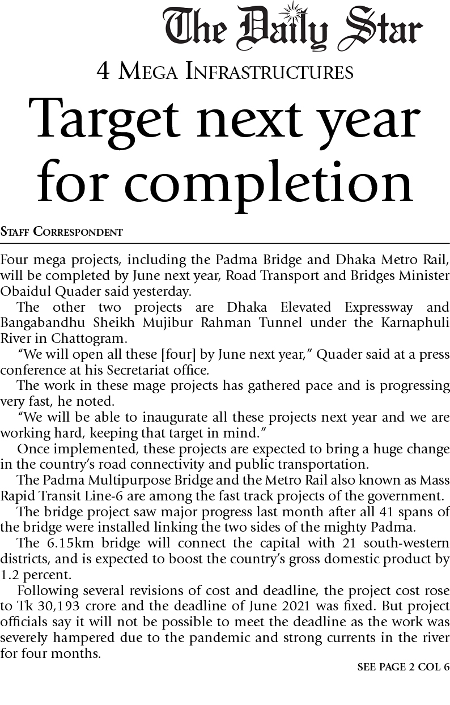
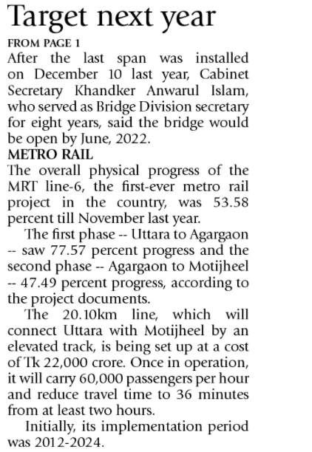
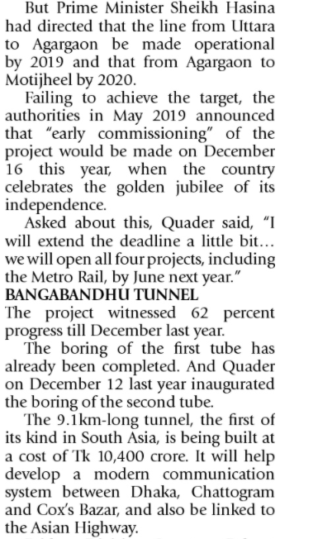

Slide 3
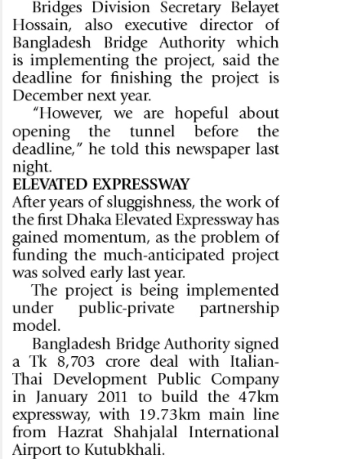
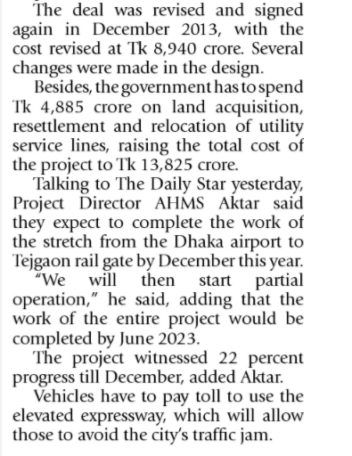
04-JAN-2021

Slide 4
In Brief
Four mega infrastructure will be completed by June 2022. They are :
1. Padma Bridge
2. Metro Rail
3. Bangabandhu Tunnel
4. Elevated Expressway
Road Transport and bridge minister Obaidul Quader said “We will open all these four by June 2021 and will able to inaugurate all these project”. Moreover, They are working very hard, keeping that target in mind.
The Padma Bridge will link the two sides of the mighty Padma and it will boost the country’s domestic product by 1.2 percent.
Bangabandhu tunnel is 9.1km long. It will help to develop a modern communication system between Dhaka, Chattogram and Cox’s Bazar.
After year of sluggishness the work of the first Dhaka Elevated Expressway has gained momentum, as the problem of funding the much-anticipated project was solved early last year . It will reduce the traffic jam of the city

Slide 5
State and Nation
Security, Stability, Prosperity are the main three goals of a state. From this news we can say that, these four mega infrastructure are the sign of prosperity of our country. Besides, it will upgrade the lifestyle of the citizens.
Legislatures
In the news we can notice that there is a fix budget for constructing each project. For maintaining or building those infrastructures Government needs a big budget and Legislature Branch of the government has control over this budget. They set and fix budgets for constructing these mega structures.
Executive Branch of Government
Road Transport and bridge minister Obaidul Quader and Bangladesh Bridge Division secretary Khandker Anwarul Islam said they will open this four mega structures in June 2022 and they are working hard to reach that goal. They are the part of Executive Branch of the Government.

Slide 6
Accountability
Accountability starts with the government. If any citizen ask that, where is his or her money going then government can answer that they are spending money in the development of the country, such as constructing streets, bridges, metro rail etc.
Power and Authority
Initially the implementation period of metro rail was 2012-2024. But Prime Minister ordered that the line from Uttara to Motijheel be made operational by 2020. Though the authorities failed the target but they gain the momentum of work and said, they will inaugurate it in the golden jubilee of Bangladesh which is 16th December 2022
International relations
For building the elevated expressway Bangladesh Bridge authorities signed a deal with Italian-Thai Development Public Company Limited

Slide 7
Political Economy
After linking two sides of Padma river our domestic product will boost by 1.2 percent. So it will raise the political state of both government and citizen.

Slide 8
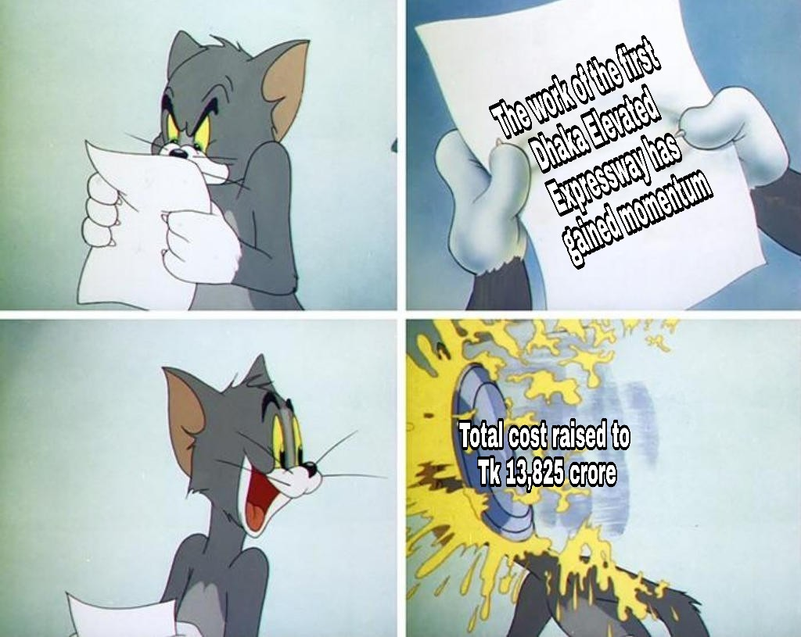

Slide 9
Thank You!

